Slide 1

WEB APPLICATION FRAMEWORK
WAF!

Slide 2

WTF IS WAF?
Web Application Framework is a software that provides a starting point for building web applications, together with useful features and functionality.
A good framework saves the time it takes to write boilerplate code and helps the developer to focus on the creative part of coding.
By choosing a good framework and using its features wisely, one can create a performant, scalable, and flexible app.
Today, web frameworks are often used to build both interactive and static websites, web APIs, and other web services.

Slide 3

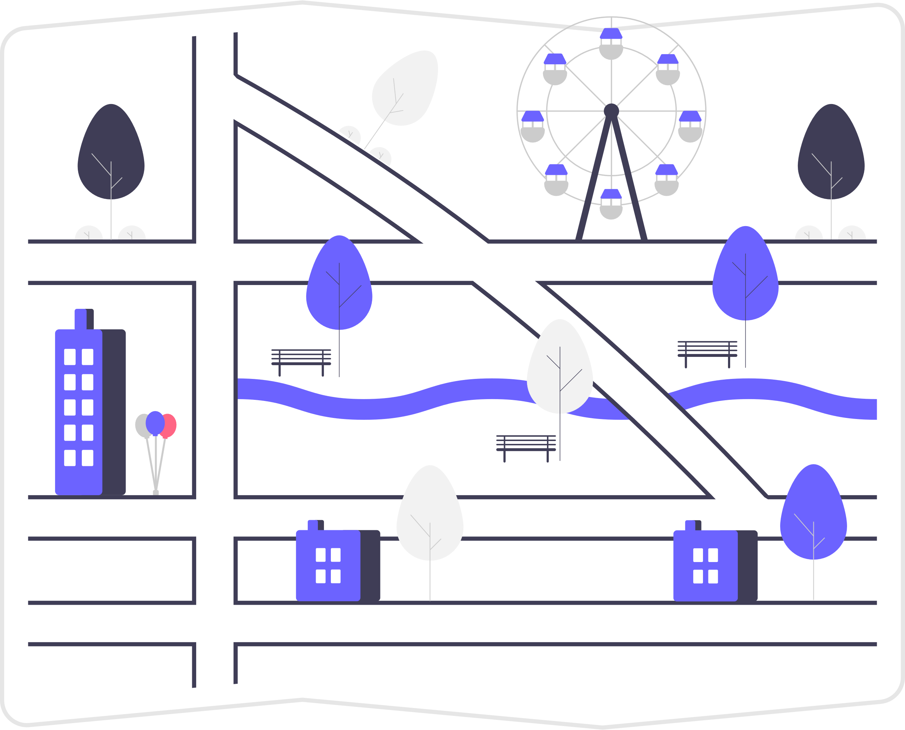
WEB SERVICE
Web Service is a server that runs and constantly listens for requests.
When a request arrives, the server can perform actions or return data.
TAKE A REST!

Slide 4
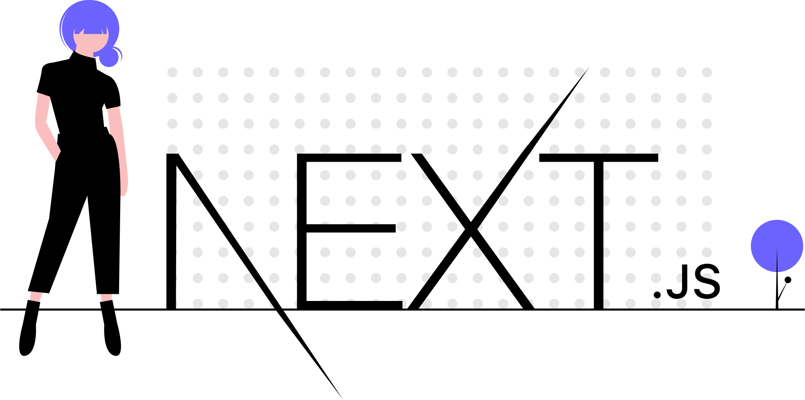

Slide 5
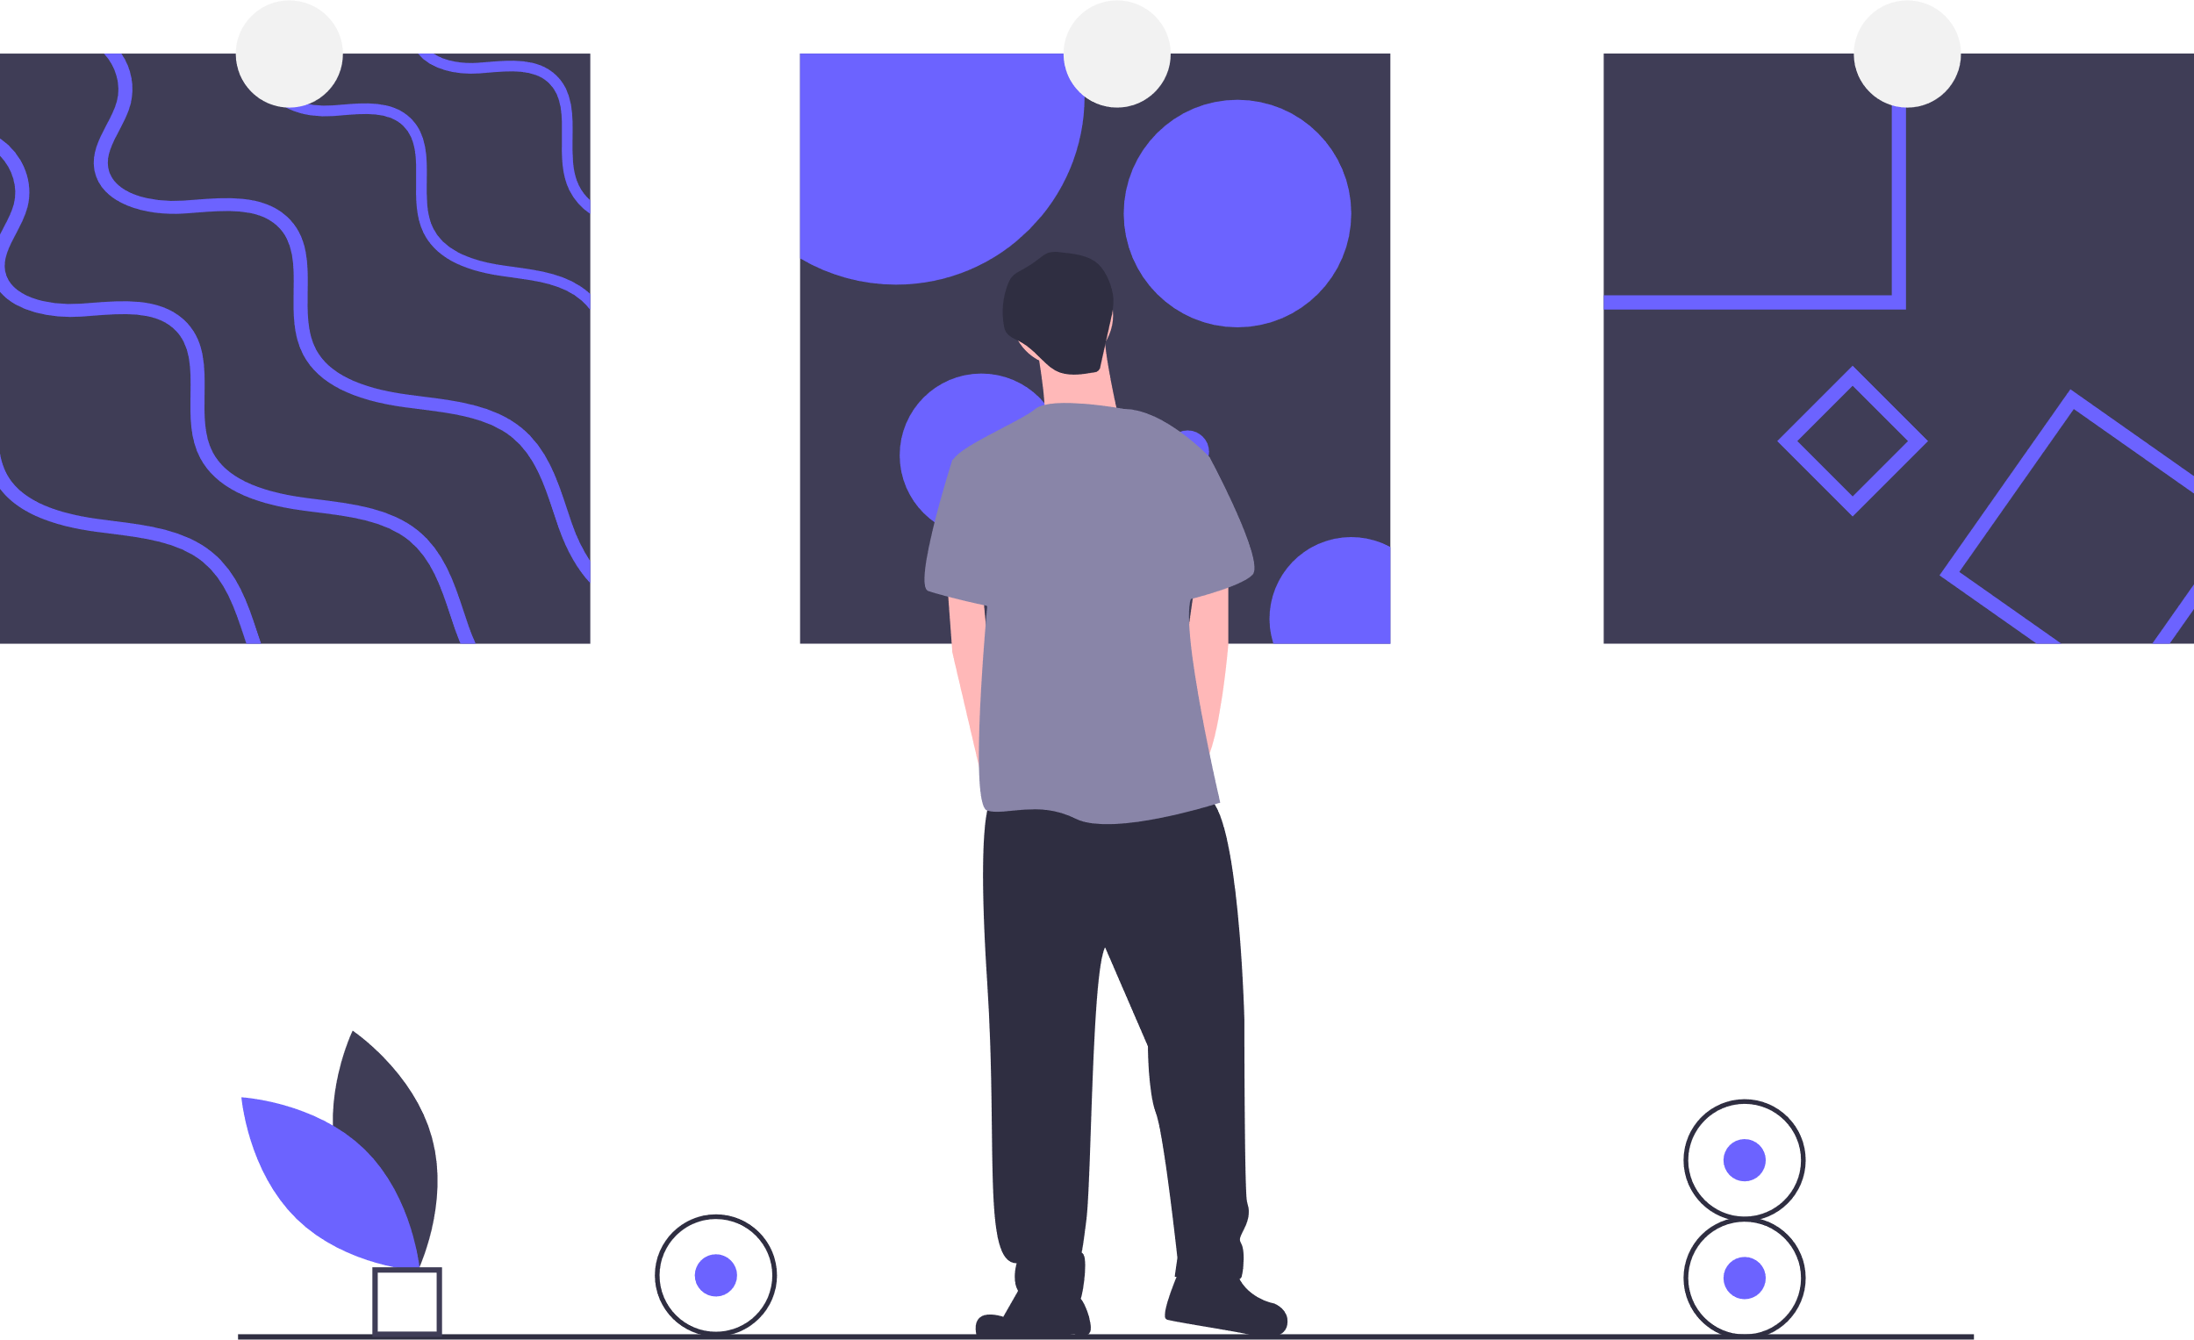



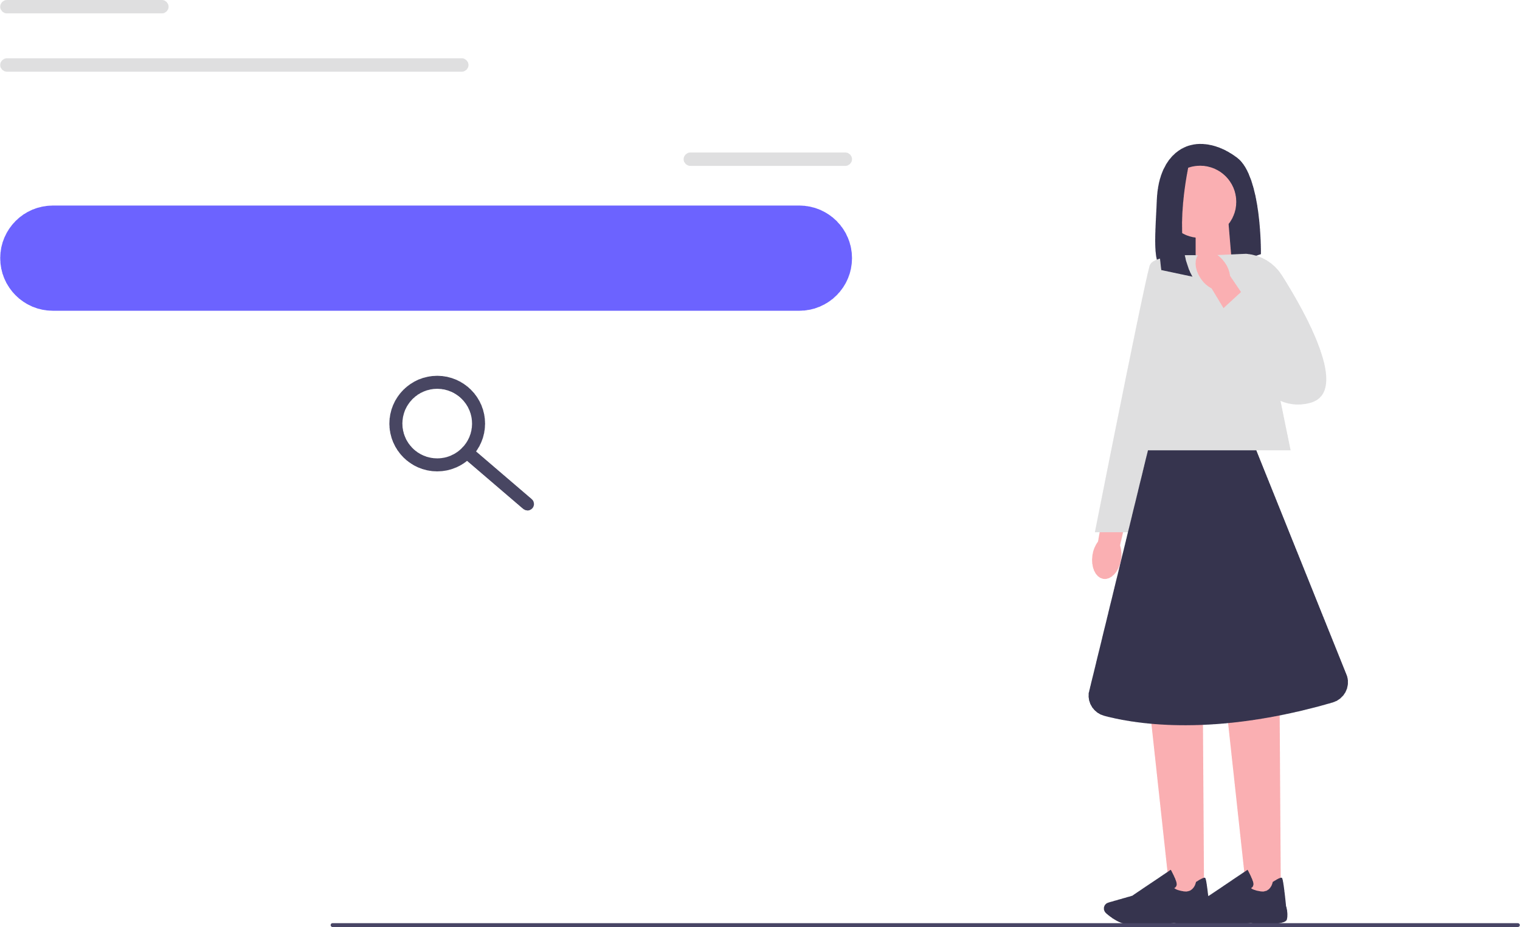
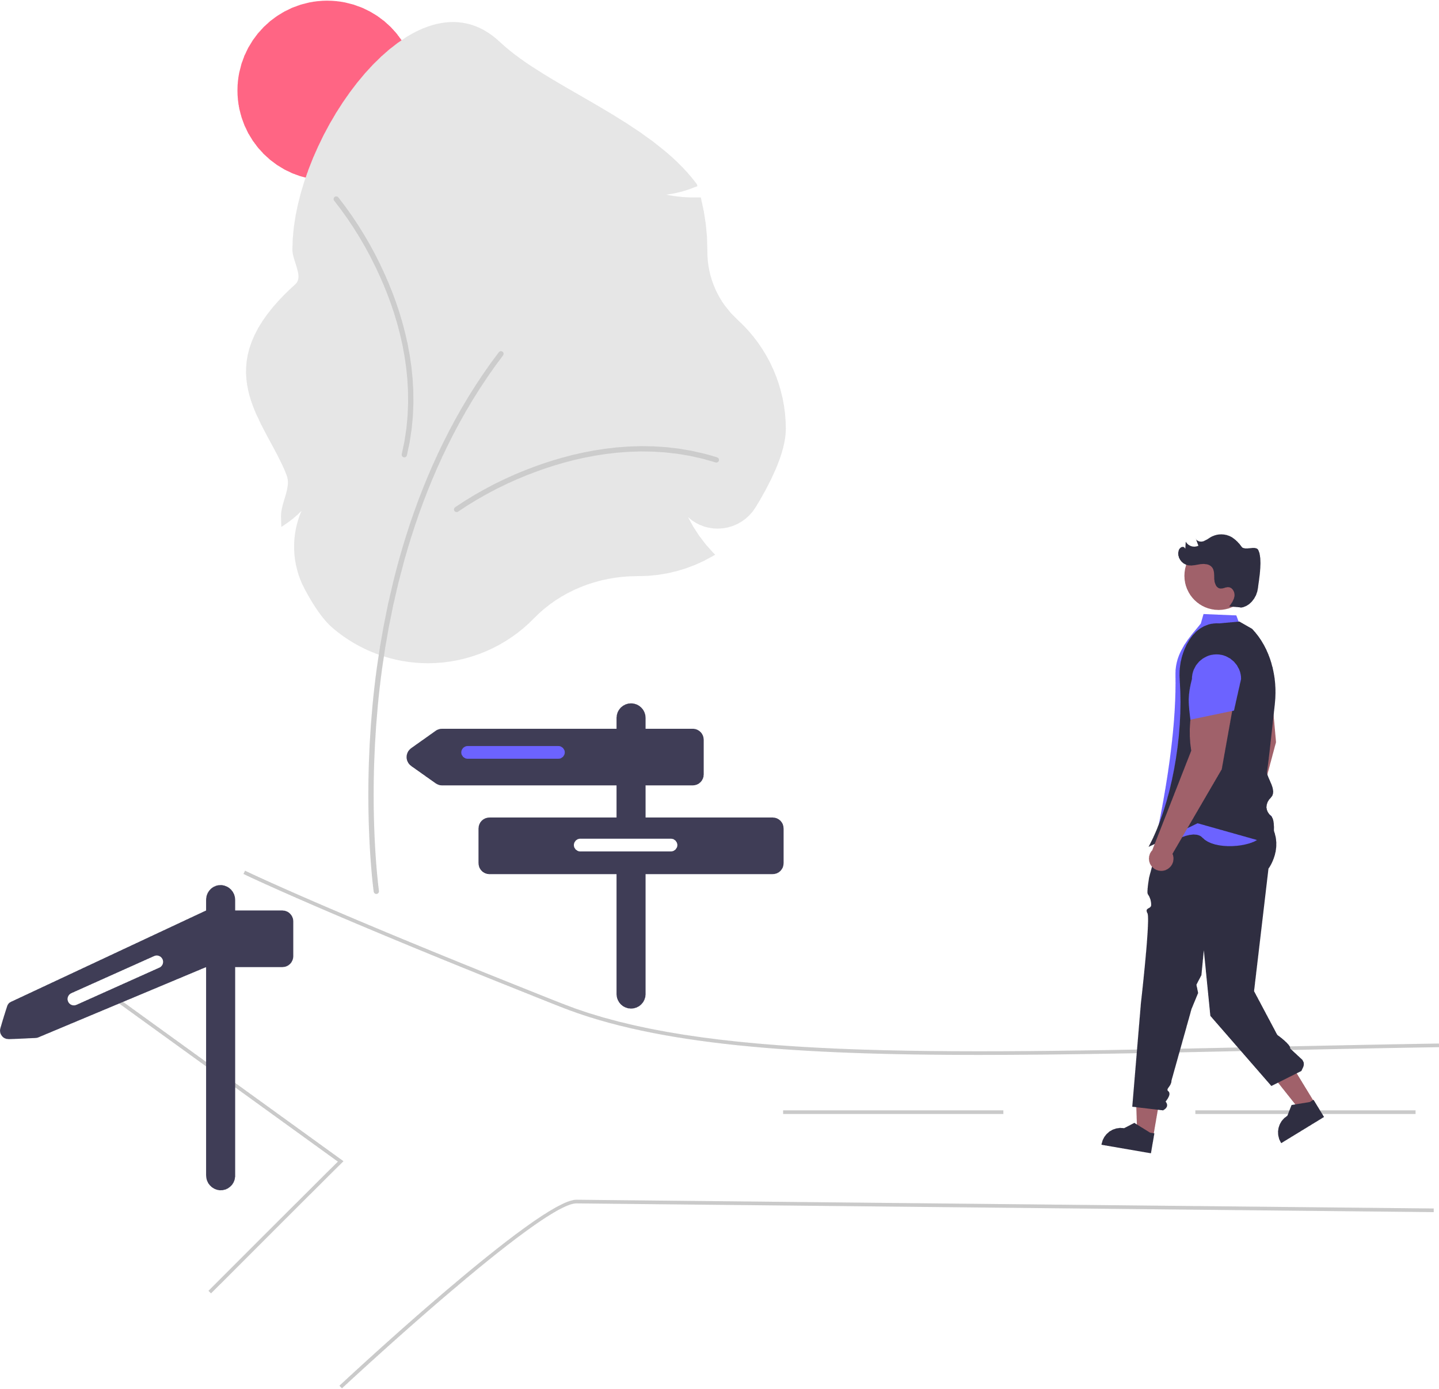
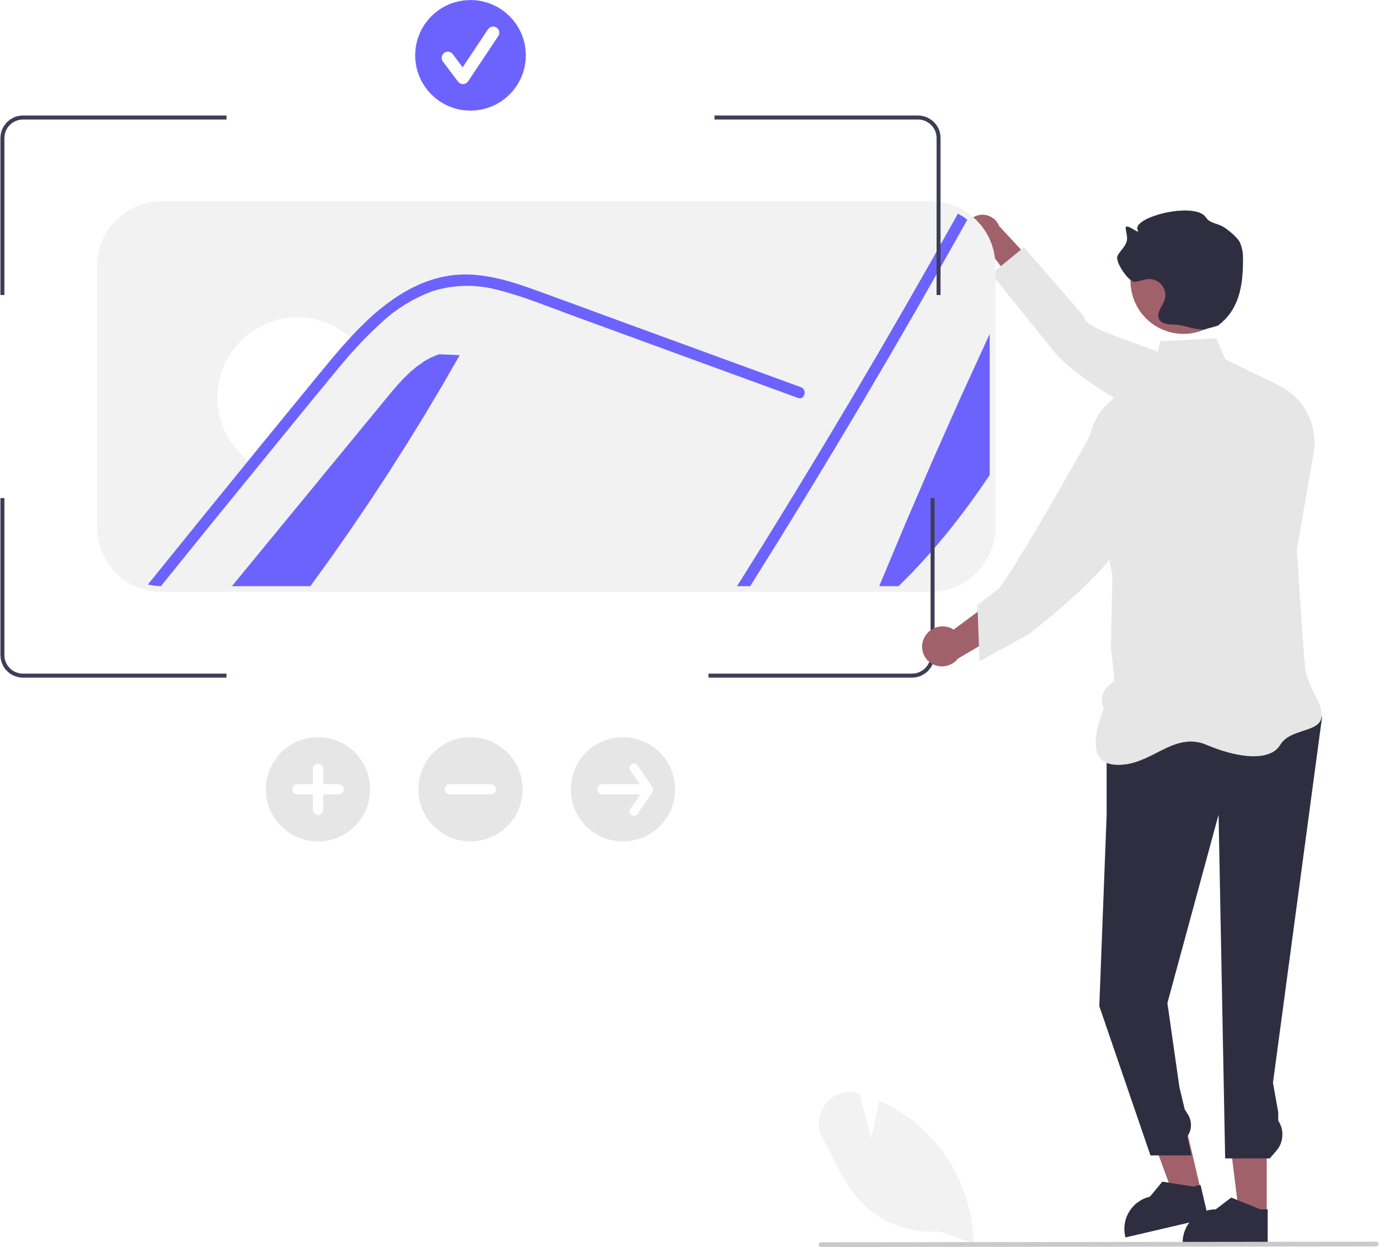
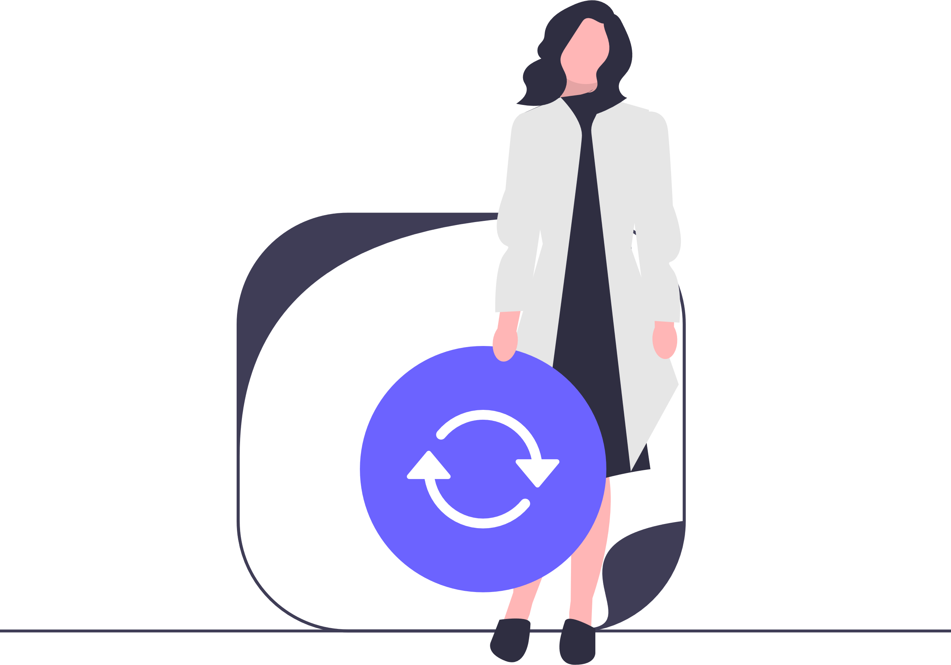
WHAT’S NEXT?
Next.js is a React framework with building blocks to create web applications.
Server-side, client-side and static rendering
Large community with lots of libraries
Hooks for interactive components
Type safe client server communication
Improved SEO
Smart page routing
Image optimization
Hot code reloading

Slide 6
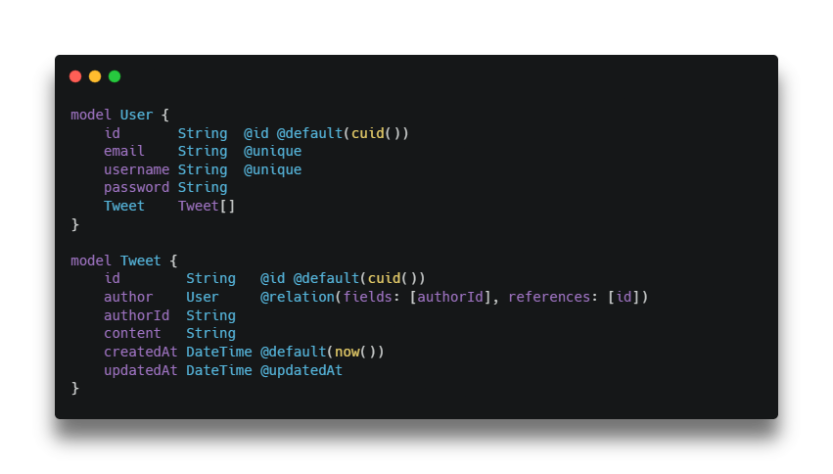

DB SCHEMA – PRISMA

Slide 7

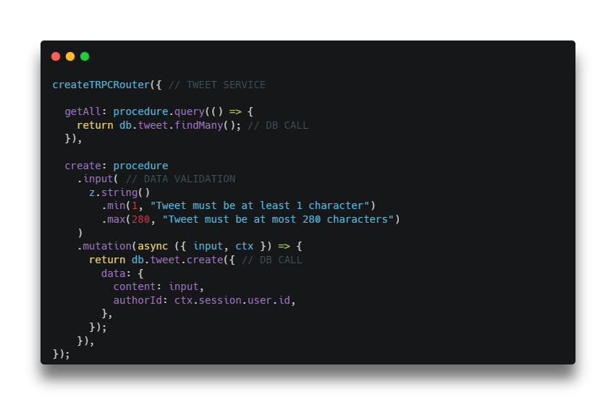

SERVICE LAYER – TRPC DATA VALIDATION - ZOD
Adaptation
Define Service

Slide 8
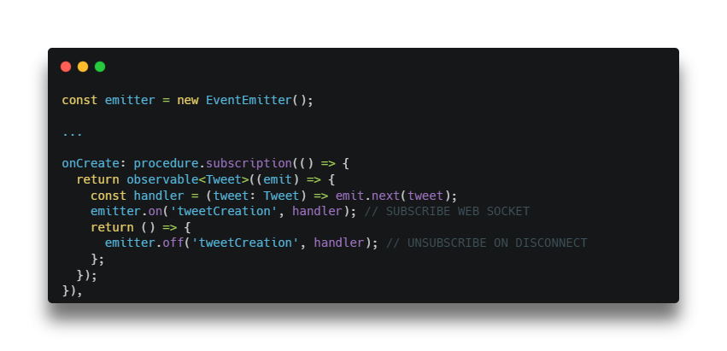
WEB SOCKETS WITH TRPC
Another Service Function

Slide 9
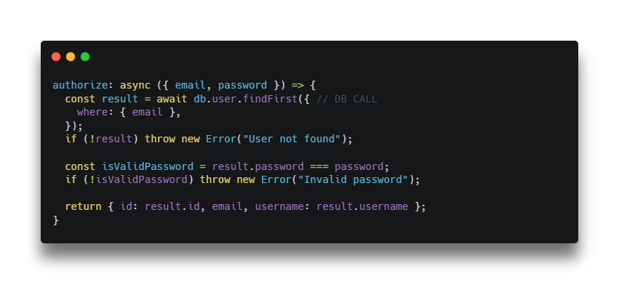

AUTH – NEXT AUTH
Adaptation
Auto JWT Generation & Validation

Slide 10
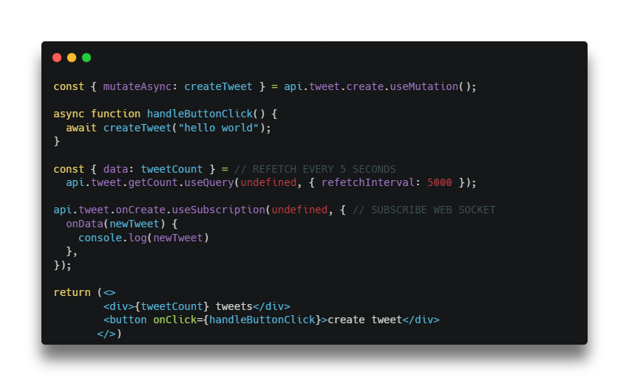


FRONTEND – REACT COMMUNICATION – REACT QUERY

Slide 11

THANKS FOR LISTENING ..
WAF!

